Slide 1
Lab 4: Impacts of False Brome Removal on the Oak Creek Watershed

Slide 2
Housekeeping
Due today
Lab 4 Pre-lab
Individual Scientific Reading Assignment
Due Next time
Scientist Spotlight

Slide 3
A
B
C
D
What species is more related to A??
a) All equally related
b) B
c) C
d) D

Slide 4
A
B
C
D
What species is more related to A??
a) All equally related
b) B
c) C
d) D

Slide 5
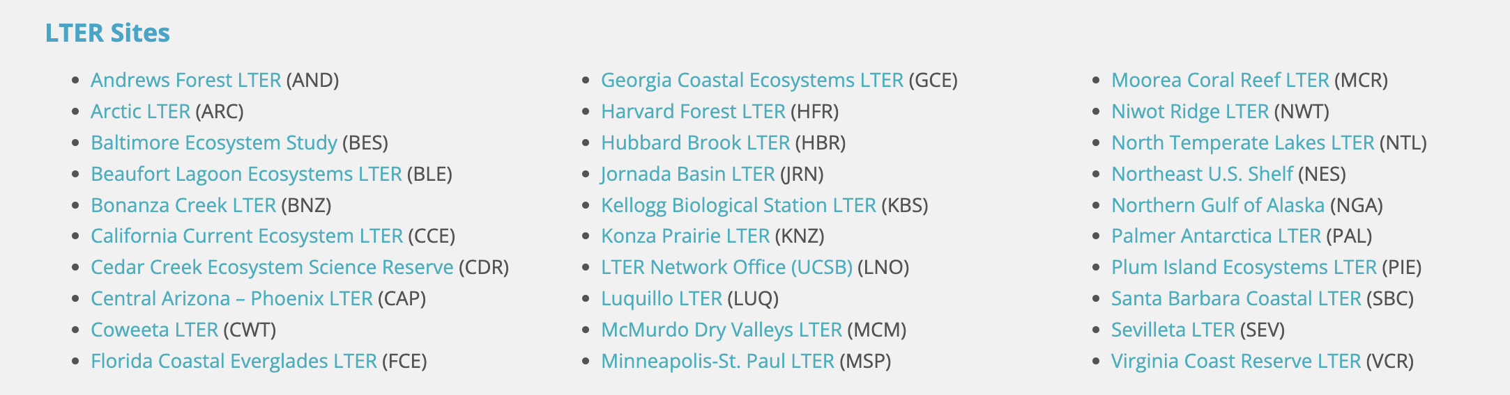
Long-Term Ecological Research (LTER)
Notes:
https://beta.nsf.gov/funding/opportunities/long-term-ecological-research-lter
To address ecological questions that cannot be resolved with short-term observations or experiments, NSF established the Long-Term Ecological Research Program (LTER) in 1980. Two components differentiate LTER research from projects supported by other NSF programs: 1) the research is located at specific sites chosen to represent major ecosystem types or natural biomes, and 2) it emphasizes the study of ecological phenomena over long periods of time based on data collected in five core areas. Long-term studies are critical to achieve an integrated understanding of how components of ecosystems interact as well as to test ecological theory. Ongoing research at LTER sites is expected to contribute to the development and testing of fundamental ecological theories and significantly advance understanding of the long-term dynamics of populations, communities and ecosystems. It often integrates multiple disciplines and, through cross-site interactions may examine patterns or processes over broad spatial scales. Recognizing that the value of long-term data extends beyond use at any individual site, NSF requires that data collected by all LTER sites be made publicly accessible.
NSF currently supports 28 LTER sites. The program is on-going and proposals are periodically invited when a need is identified to balance the LTER portfolio or when funding opportunities arise to support new LTERs. These opportunities are announced through separate solicitations. This solicitation governs submission of renewal proposals for active LTER site awards.
**The Andrews Forest Program at the H.J. Andrews Experimental Forest is administered cooperatively by the USDA Forest Service's Pacific Northwest Research Station, Oregon State University, and the Willamette National Forest. Funding comes from the National Science Foundation, Pacific Northwest Research Station, Oregon State University and the College of Forestry, charitable support, and other sources. The Andrews Forest LTER program is one of 28 major ecosystem research sites funded through NSF's Long-Term Ecological Research

Slide 7
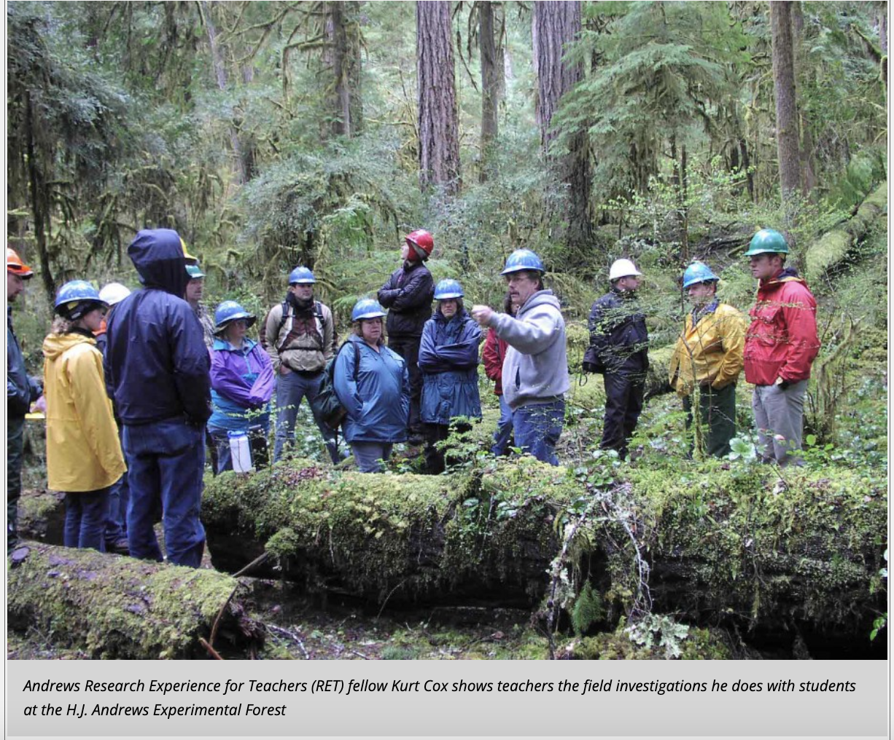

Slide 8
BI22X LTER: Hand Pulling False Brome
10 + years of data examining the plant community at this location
Data collected by students in BI22x
Project goal:
How effective is hand pulling at eradicating False Brome?
Method:
Area designated for hand pulling
Area designated as a control
This is long term ecological research done by you!

Slide 9
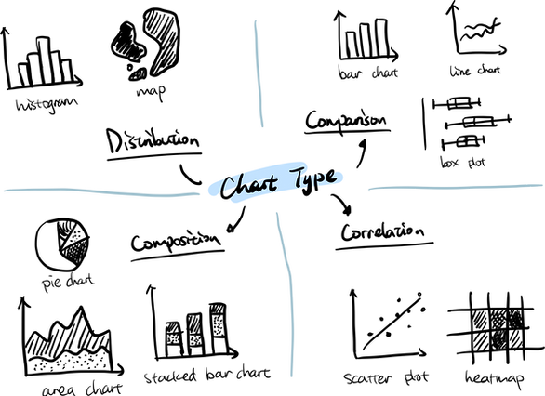
Choosing a Figure
It is important to consider your research question when choosing a figure!

Slide 10
Bar vs Box and Whisker
Outlier
Some measure of data variance
Max within 1.5 IQR
Average
Upper quartile
Median
Lower quartile
Min within 1.5 IQR

Slide 11
Bar vs Box and Whisker
Some measure of data variance
}
25%
Average
{
}
25%
50%
}
Median
25%
}
25%

Slide 12
Bar v box: making visual comparisons
The maximum of one error bar is less than the minimum of another (no overlap of error bars)
The median of one group lies outside the box of another
Compare box sizes/range

Slide 13
Bar v box: making visual comparisons
DO NOT RELY ON VISUAL COMPARISONS
Rely on statistical analysis to determine significance
The maximum of one error bar is less than the minimum of another (no overlap of error bars)
The median of one group lies outside the box of another
Compare box sizes/range

Slide 14
Part 1: Group Experimental Design
Take turns pitching the QHP you outlined for your pre-lab
Develop a group research plan and complete the group research form
You can even pilot this question in Part 2!

Slide 15
Before we start part 2…
Please don’t use your personal computers for this part!!
Turn on both computers on your table
Log-in into Canvas
Open your RStudio Server
Go to File > New File > R Script

Slide 16
Part 2: Practice Data Analysis
Using 2022 data, you and your group can practice analyzing data
Begin by carefully examining the dataset and reading through the data dictionary provided
Consider the following question:
Is mean shrub richness (# of species) different in the non-pulling section than the pull section?
What data do you need to answer this question?
Shrub richness
Information about the plot – pull vs. non pull; before vs. after (pull only)

Slide 17
Part 2: Practice Data Analysis
Subsetting
Extracting a smaller sized portion of the data from the larger dataset
Today, we will practice subsetting the data needed to answer this specific question
T-Test
Goal: Is there a significant different between the means of two groups?
Today, we will practice comparing shrub richness in the non-pulling section to the pulling section (specifically before pulling)
Why might this be important? Why not use the before and after data?

Slide 18
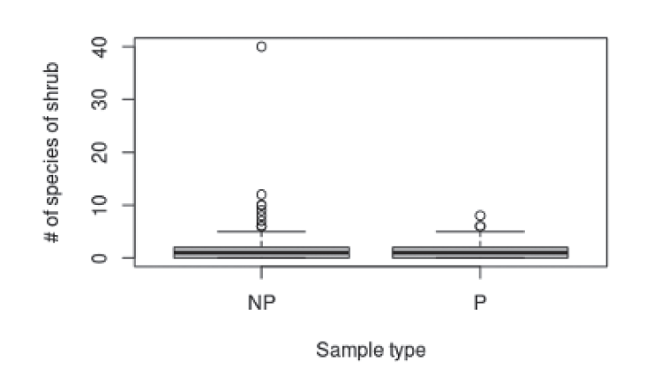
Part 3: Creating Figures
Consider this figure:
What is the explanatory variable?
What is the response variable?
What does the thick black line represent? The gray?
What type of data yields itself best to to this type of plot? Why?
If you were to create a figure caption for this figure, what might it say?

Slide 19
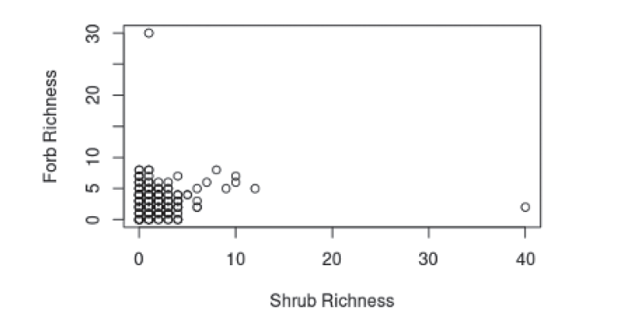
Part 3: Creating Figures
Consider this figure:
What is the explanatory variable?
What is the response variable?
What type of data yields itself best to to this type of plot? Why?
If you were to create a figure caption for this figure, what might it say?

Slide 20
Part 3: Creating Figures
Create a boxplot comparing shrub species richness from pulled vs. non-pulled plots
Create a scatterplot comparing the relationship between two variables (shrub richness and herbaceous richness)

Slide 21

Secret Part 4: Modify Code to Answer your Research Question
Modify the code provided to create figures which answer your research question using last year’s data.
This may take a long time (that’s okay!)
Save this code so you can reference it when we analyze this year’s data

Slide 22
Some R tips
data_np <- data[which(data$pulled == “N”),]
t.test(data_pb$shrub_rich, data_np$shrub_rich)
boxplot(data_np$shrub_rich, data_pb$shrub_rich,
names = c(“Non-pull area”, “Pull area, before pulling”),
col = c(“red”, “green”))
fit <- lm(herb_rich ~ shrub_rich, data = data_np)
summary(fit)
plot(data_np$herb_rich, data_np$shrub_rich, ...)

